Slide 1
Polymorphism
Vu Tuan Hai

Slide 2
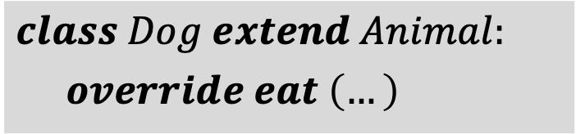
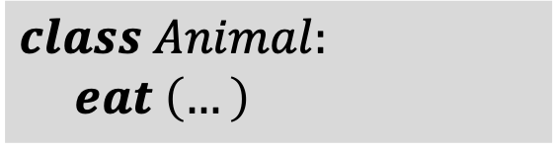
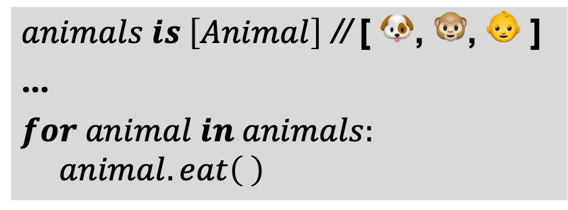
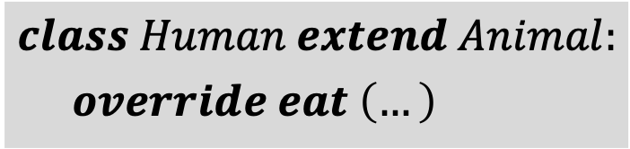
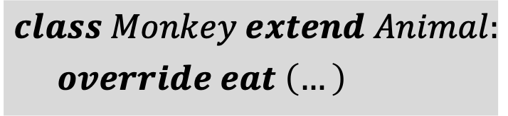
Polymorphism (1/9)
Polymorphism occurs when there is inheritance among classes.
Animal
$$class Animal:$$
$$eat \left(…\right)$$
$$class Dog extend Animal:$$
$override eat \left(…\right)$
Dog
Human
Monkey
$animals is \left[Animal\right]$ // [ 🐶, 🐵, 👶 ]
…
$for animal in animals:$
$$animal.eat\left( \right)$$
$$class Human extend Animal:$$
$override eat \left(…\right)$
How to save diff type of obj into a unify var?
$$class Monkey extend Animal:$$
$override eat \left(…\right)$
How do program know exact methods?

Slide 3
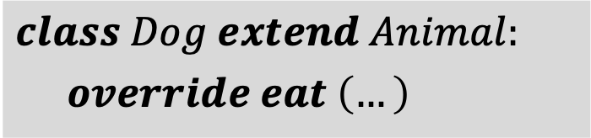
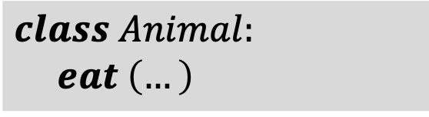
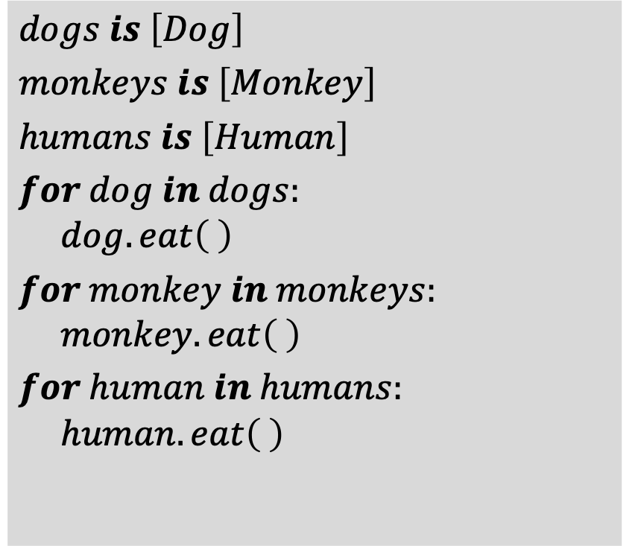
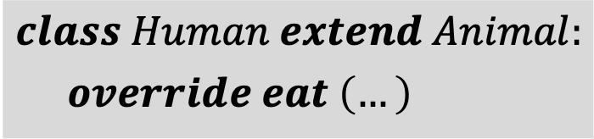
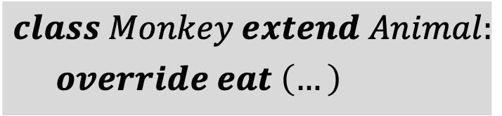
Polymorphism (2/9) Solution: creating multiple list
$$dogs is \left[Dog\right]$$
$monkeys is \left[Monkey\right]$
$humans is \left[Human\right]$
$for dog in dogs:$
$$dog.eat\left( \right)$$
$for monkey in monkeys:$
$$monkey.eat\left( \right)$$
$for human in humans:$
$$human.eat\left( \right)$$
$$class Animal:$$
$$eat \left(…\right)$$
$$class Dog extend Animal:$$
$override eat \left(…\right)$
$$class Human extend Animal:$$
$override eat \left(…\right)$
$$class Monkey extend Animal:$$
$override eat \left(…\right)$
Calling directly, simple but not clean

Slide 4
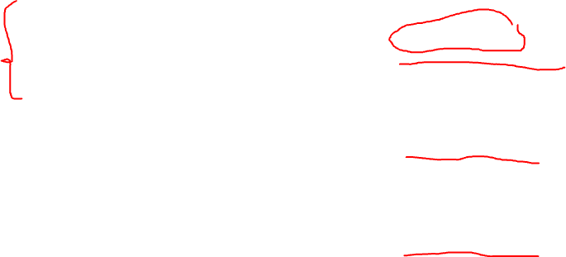
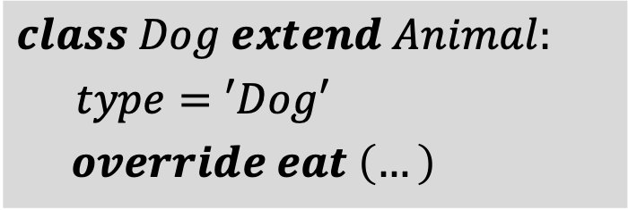
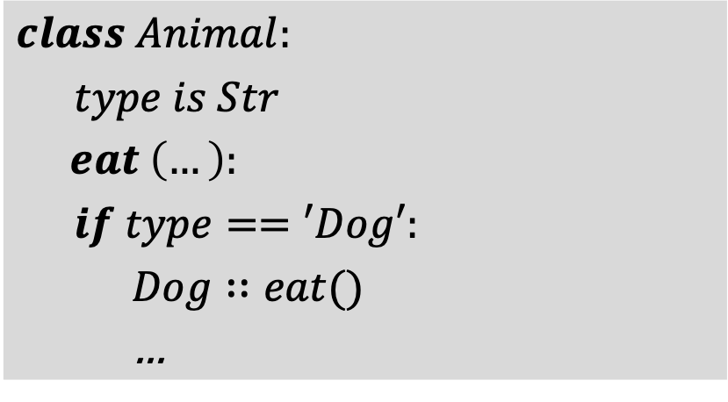
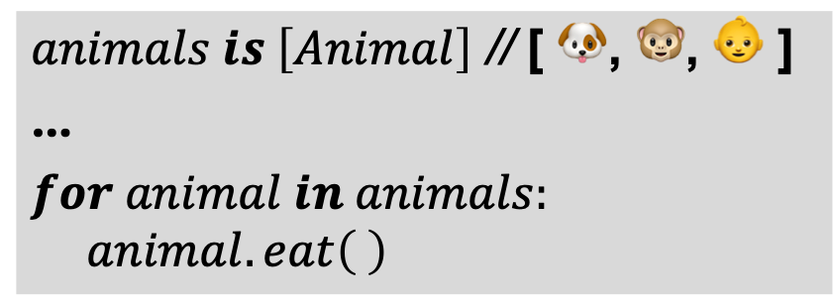
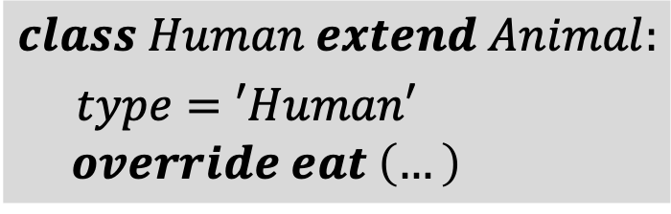
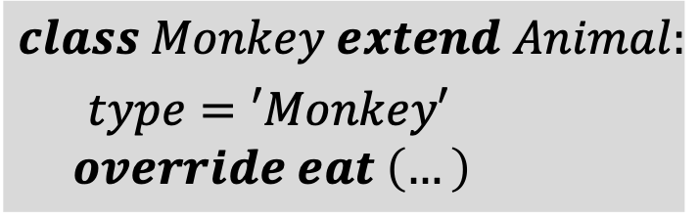
Polymorphism (3/9) Solution: using type variable
$animals is \left[Animal\right]$ // [ 🐶, 🐵, 👶 ]
…
$for animal in animals:$
$$animal.eat\left( \right)$$
$$class Dog extend Animal:$$
$type=′Dog′$
$override eat \left(…\right)$
$$class Human extend Animal:$$
$type=′Human′$
$$override eat \left(…\right)$$
$$class Animal:$$
$type is Str$
$eat \left(…\right)$:
$if type==′Dog′:$
$Dog∷eat()$
…
$$class Monkey extend Animal:$$
$type=′Monkey′$
$$override eat \left(…\right)$$

Slide 5
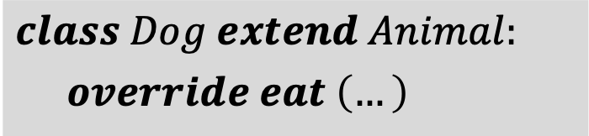

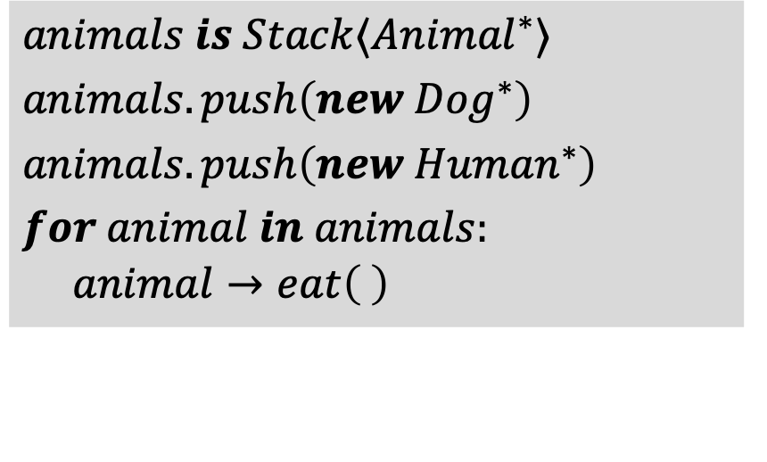
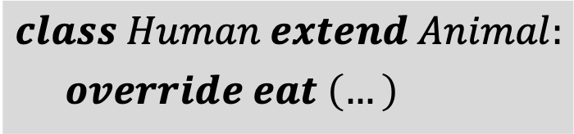
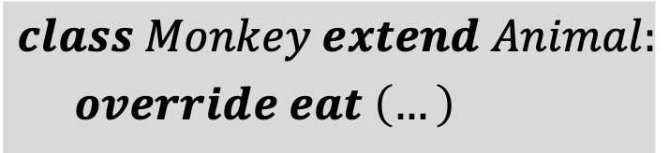
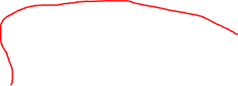
Polymorphism (4/9) Solution: using list of pointer
$$animals is Stack⟨{Animal}^{∗}⟩$$
$animals.push\left(new {Dog}^{∗}\right)$
$animals.push\left(new {Human}^{∗}\right)$
$for animal in animals:$
$$animal→eat\left( \right)$$
$$class Animal:$$
$$eat \left(…\right)$$
$$class Dog extend Animal:$$
$override eat \left(…\right)$
$$class Human extend Animal:$$
$override eat \left(…\right)$
Now only $Animal∷eat()$is called
Why list of pointers can store diff type of objects?
$$class Monkey extend Animal:$$
$override eat \left(…\right)$

Slide 6
Polymorphism (5/9) Solution: using list of pointer
$$animals is Stack⟨{Animal}^{∗}⟩$$
$animals.push\left(new {Dog}^{∗}\right)$
$animals.push\left(new {Human}^{∗}\right)$
$for animal in animals:$
$$animal→eat\left( \right)$$
$$class Animal:$$
$$eat \left(…\right)$$
$$class Dog extend Animal:$$
$override eat \left(…\right)$
$$class Human extend Animal:$$
$override eat \left(…\right)$
Why list of pointers can store diff type of objects?
$$class Monkey extend Animal:$$
$override eat \left(…\right)$
Now only $Animal::eat()$is called

Slide 7
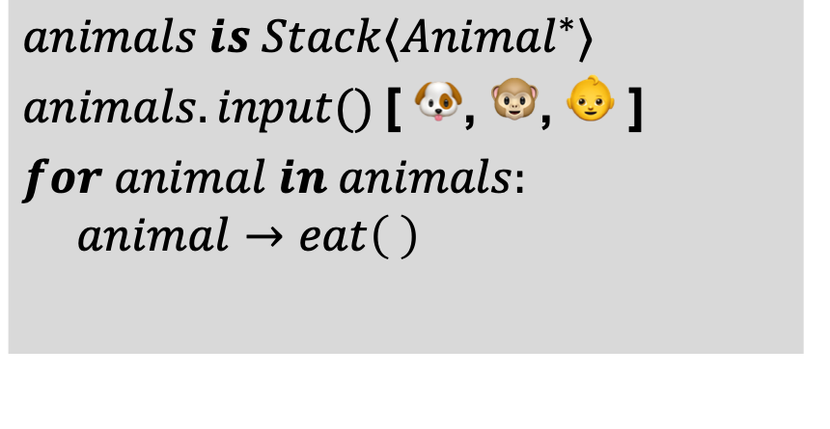
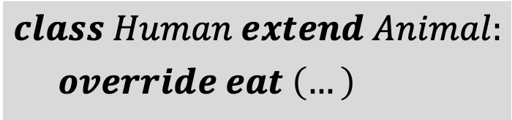

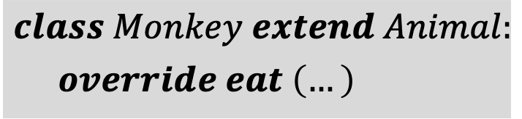

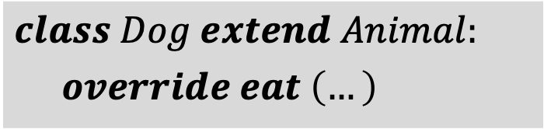
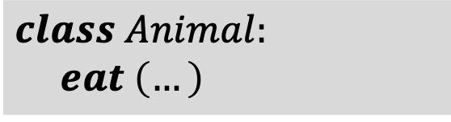
Polymorphism (6/9) Solution: using list of pointer
$$class Animal:…$$
$class Dog extend Animal:…$
$class Human extend Animal:$ …
$class Monkey extend Animal:$ …
$$class Animal:$$
$$eat \left(…\right)$$
Compile time
Static binding
$$class Dog extend Animal:$$
$override eat \left(…\right)$
$$animals is Stack⟨{Animal}^{∗}⟩$$
$animals.input()$ [ 🐶, 🐵, 👶 ]
$for animal in animals:$
$$animal→eat\left( \right)$$
$$class Human extend Animal:$$
$override eat \left(…\right)$
$$class Monkey extend Animal:$$
$override eat \left(…\right)$
Time

Slide 8

Polymorphism (7/9) Solution: using list of pointer
$$class Animal:…$$
$class Dog extend Animal:…$
$class Human extend Animal:$ …
$class Monkey extend Animal:$ …
$$class Animal:$$
$$virtual eat \left(…\right)$$
Static binding/dispatch
Compile time
$$class Dog extend Animal:$$
$override eat \left(…\right)$
$$animals is Stack⟨{Animal}^{∗}⟩$$
$animals.input()$ [ 🐶, 🐵, 👶 ]
$for animal in animals:$
$$animal→eat\left( \right)$$
$$class Human extend Animal:$$
$override eat \left(…\right)$
$$class Monkey extend Animal:$$
$override eat \left(…\right)$
Time
Run time
Dynamic binding/dispatch

Slide 9
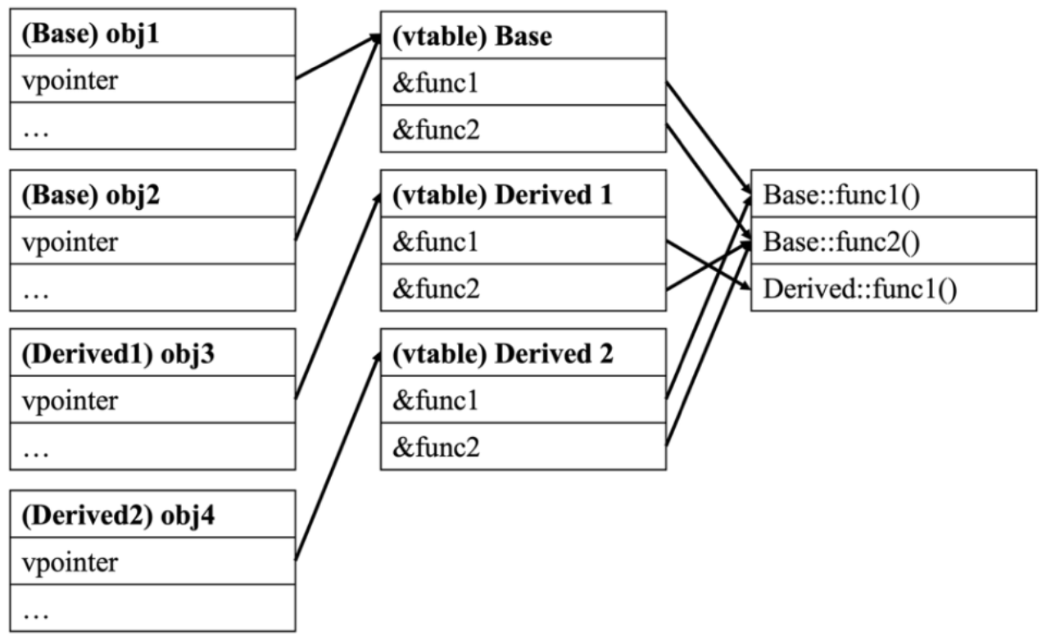
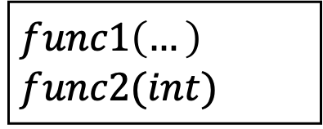

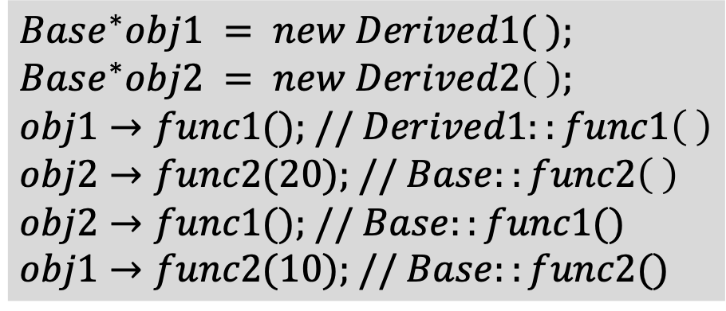
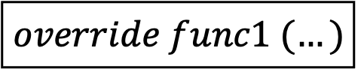


Polymorphism (8/9) Solution: using list of pointer / How do virtual functions work?
Example:
$$Base^{∗}obj1 = new Derived1( );$$
$$Base^{∗}obj2 = new Derived2\left( \right);$$
$$obj1→func1(); // Derived1::func1\left( \right)$$
$$obj2→func2(20); // Base::func2\left( \right)$$
$$obj2→func1(); // Base::func1()$$
$$obj1→func2(10); // Base::func2()$$
$$Derived1$$
$$Base$$
$$override func1 (…)$$
$$func1\left(…\right)$$
$$func2(int)$$
$$Derived2$$
Compiled objs
Vtables
Functions

Slide 10
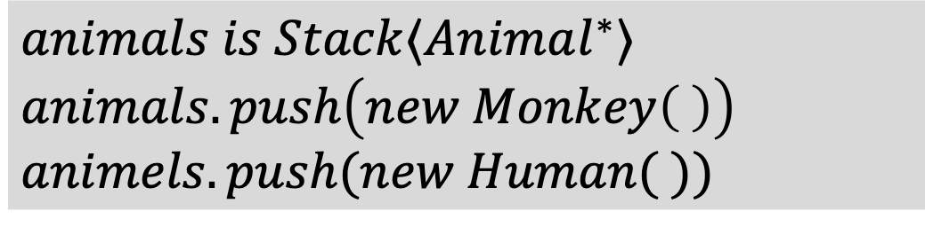


Polymorphism (9/9)
Some notes:
A pointer of the base class can point to the derived class:
$$Animal^{∗} animal=new Monkey\left( \right);$$
Then
$$animals is Stack⟨Animal^{∗}⟩$$
$animals.push\left(new Monkey\left( \right)\right)$
$$animels.push(new Human( ))$$

Slide 11
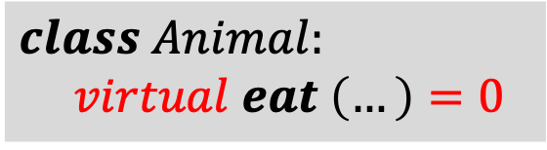
Virtual function (1/2) Pure virtual function
$$class Animal:$$
$$virtual eat \left(…\right)=0$$
In some case, a method does not have anything
We can assign it to 0 (C++) or use abstract keyword (Java)
Extended class must implement pure virtual method
Class with virtual method: abstract class
Class with all pure virtual method: interface

Slide 12
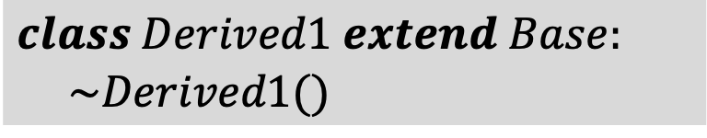
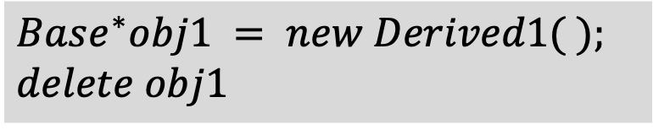
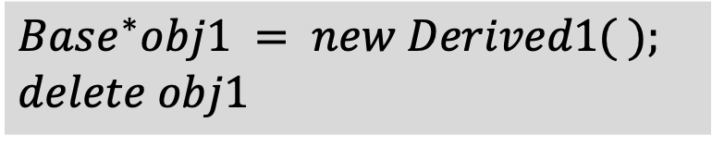
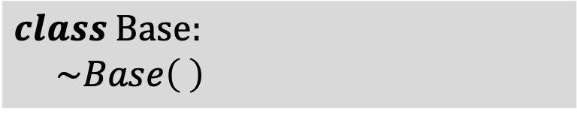


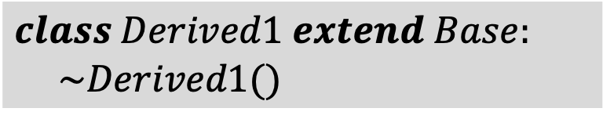
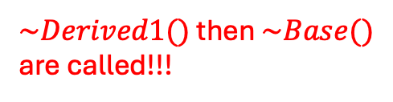
Virtual function (2/2) Virtual destructor
$$class Base:$$
$$\sim Base\left( \right)$$
$$Base^{∗}obj1 = new Derived1( );$$
$$delete obj1$$
$$class Derived1 extend Base:$$
$$\sim Derived1()$$
Only $\sim Base()$is called!!!
$$class Base:$$
$$virtual \sim Base\left( \right)$$
$$Base^{∗}obj1 = new Derived1( );$$
$$delete obj1$$
$$class Derived1 extend Base:$$
$$\sim Derived1()$$
$\sim Derived1()$ then $\sim Base()$ are called!!!
Destructor chain is only available for destructor method
Why there is no virtual constructor?

